Slide 1
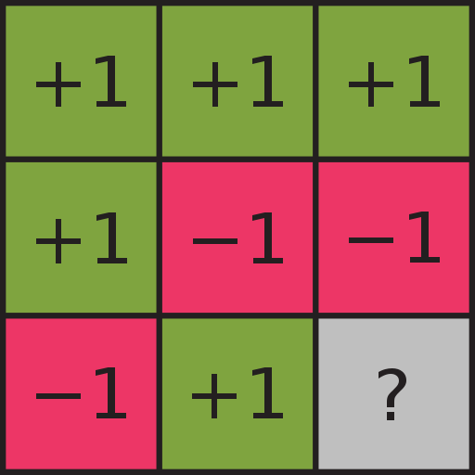


Bachelor Thesis: The Mermin Peres Magic Square Game on Real Quantum Computers
David Drexlin
Corporate Student, IBM

Slide 2
Outline
The Mermin Peres Magic Square Game
Mathematical Scheme of Operation
Quantum Circuit: MPG
Results on real Quantum Computers with Qiskit

Slide 3



History of the MPG
The Mermin-Peres Magic Square Game is based on proofs of Mermin (1990) and Peres (1990) detailing the impossibility of a non-contextual model with hidden variables refuting the deterministic dissent of the Einstein–Podolsky–Rosen paradox.
A game-theoretic description combined the proofs of Mermin and Peres into the so called Mermin-Peres Magic Square Game (2002)
Sergey Bravyi et al. extended and proved a theoretical quantum advantage of a n-dimensional game over classical systems on Noisy Intermediate-Scale Quantum Computers (2020)
A Qiskit blog post further described the quantum circuit architecture outlined by Bravyi et. al. (2021)
https://cpb-us-e1.wpmucdn.com /blog.umd.edu /dist/0/196/files/2015/10/Peres1990-2g8uzi6.pdf
https://arxiv.org/abs/quant-ph/0407221
https://medium.com/qiskit/this-proof-demonstrates-a-quantum-advantage-even-for-noisy-quantum-computers-b44a738801ad
https://www.nature.com/articles/s41567-020-0948-z

Slide 4


Ruleset of the MPG
m_{i,1}
m_{i,2}
m_{i,3}
m_{1,j}
m_{2,j}
Alice
Bob
m_{3,j}

Slide 5


Ruleset of the MPG
Each column’s product is -1
Each row’s product is +1
The moves played respectivly intersecting cell are equal
${\underset{j=1}{\overset{3}{Π}} m}_{i,j}=−1$ $∀ i,j∈1,2,3$
${\underset{i=1}{\overset{3}{Π}} m}_{i,j}=+1 ∀ i,j∈1,2,3$
Alice and Bob have to fill one row and column to win the game, adhering to the rules:
Alice
Bob
$$M = \left(mi,j\right)i,j = 1,2,3$$

Slide 6

Winning Condition: Alice – Example: Column 1 Selected
m_{i,1}
m_{1,j}
$${\underset{i=1}{\overset{3}{Π}} m}_{i,1}=−1$$
m_{2,j}
m_{3,j}

Slide 7




Winning Condition: Alice – Example: Column 1 Selected
m_{i,1}
m_{1,j}
$${\underset{i=1}{\overset{3}{Π}} m}_{i,1}=−1$$
m_{2,j}
$$=\text{m}\text{1,}\text{1 }\text{* }\text{m}\text{2.1}\text{∗ }\text{m}\text{3.1}$$
$$= −1 ∗ 1 ∗ 1$$
$$= −1$$
m_{3,j}

Slide 8

Winning Condition: Bob – Example: Row 1 Selected
m_{i,1}
m_{i,2}
m_{i,3}
m_{1,j}
$${\underset{j=1}{\overset{3}{Π}} m}_{1,j}=+1$$

Slide 9



Winning Condition: Bob – Example: Row 1 Selected
m_{i,1}
m_{i,2}
m_{i,3}
m_{1,j}
$${\underset{j=1}{\overset{3}{Π}} m}_{1,j}=+1$$
$$=\text{m}\text{1,}\text{1 }\text{* }\text{m}\text{1.2}\text{∗ }\text{m}\text{1,3}$$
$$= 1 ∗ 1 ∗ 1$$
$$= +1$$

Slide 10


Selections combined…
m_{i,1}
m_{i,2}
m_{i,3}
m_{1,j}
Because, $m_{i,j}∗m_{h,l}=m_{h,l}∗m_{i,j} ∀i,j,h,l$
holds that$−1 {=\underset{i=1}{\overset{3}{Π}}\underset{j=1}{\overset{3}{Π}}m}_{i,j}=+1 \text{↯}$ … →Hence, any strategy, even with prior collusive agreement cannot yield a 100% winning probability.
m_{2,j}
m_{3,j}

Slide 11
Classical Nash Equilibrium – MPG
The example shows a prior collusive agreement with a winning probability of 8

Slide 12
Mermin Peres Magic Square and Quantum Principles
Can we use Quantum Principles and improve on the 8/9 winning probability?
We can, using Pauli-Matrices
Notes:
The MPG-implementation with Quantum Principles of Superposition and Entanglement were first described by Mermin and Peres, to prove the Bell-Kochen-Specker Theorem such that a winning probability of 100% could be achieved using Pauli-Operators…

Slide 13
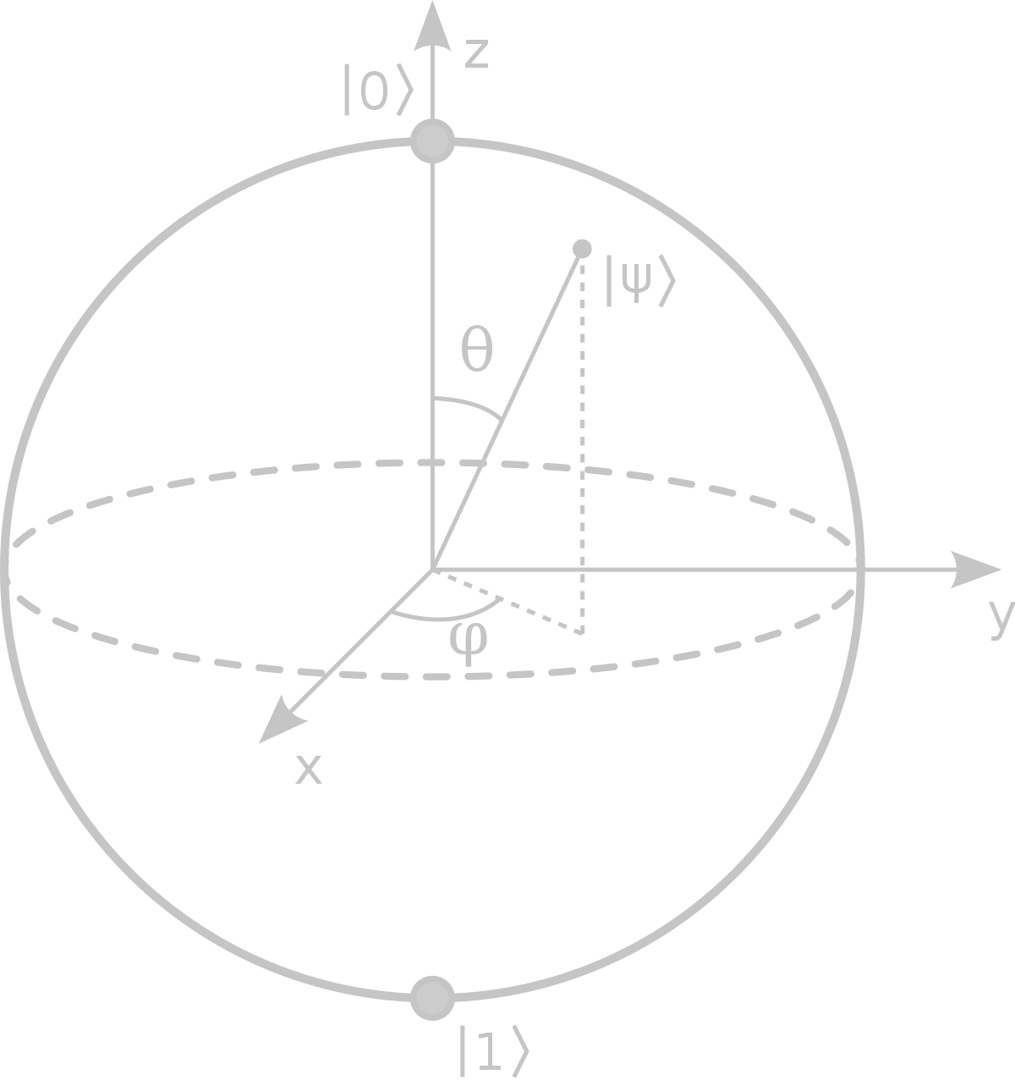







Mermin Peres Magic Square using Pauli Operators
Pauli-Matrices:
$$I= \left[\begin{matrix}1 & 0 \\ 0 & 1\end{matrix}\right]$$
$$X= \left[\begin{matrix}0 & 1 \\ 1 & 0\end{matrix}\right]$$
$$Z= \left[\begin{matrix}1 & 0 \\ 0 & −1\end{matrix}\right]$$
$$Y= \left[\begin{matrix}0 & −i \\ i & 0\end{matrix}\right]$$
$$H= \frac{1}{\sqrt{2}}\left[\begin{matrix}1 & 1 \\ 1 & −1\end{matrix}\right]$$
$$S= \left[\begin{matrix}1 & 0 \\ 0 & i\end{matrix}\right]$$
Additional-Matrices:
Properties:
$$Self−Inverse:{ X}^{2}=Z^{2}=Y^{2} \text{= }\text{I} \\ X, Y, Z Pairwise Anti−Commute e.g. XY=−YX, \\ XZ=iZ=−ZX \\ , \\ X=HZH \\ Y={\left(HS^{†}\right)}^{†}Z(HS^{†}) \\ Z=IZI$$
Notes:
$A=πr^{2}$The MPG-implementation with Quantum Principles of Superposition and Entanglement were first described by Mermin and Peres, to prove the Bell-Kochen-Specker Theorem such that a winning probability of 100% could be achieved using Pauli-Operators…

Slide 14





Mermin Peres Magic Square – Pauli Operators
m_{i,1}
m_{i,2}
m_{i,3}
X₁ ⊗ I₂
I₁ ⊗ X₂
X₁ ⊗ X₂
m_{1,j}
I $⊗I$
I₁ ⊗ Z₂
Z₁ ⊗ I₂
Z₁ ⊗ Z₂
m_{2,j}
I $⊗I$
-X₁ ⊗ Z₂
-Z₁ ⊗ X₂
Y₁ ⊗ Y₂
m_{3,j}
I $⊗I$
$$−(I⊗I)$$
$$−(I⊗I)$$
$$−(I⊗I)$$

Slide 15
Combined Rules with Pauli Operators
$$m_{1,j}≔\left(X⊗I\right)\left(I⊗X\right)(X⊗X)=(X⊗X)\left(X⊗X\right)=(I⊗I)$$
$$m_{2,j}≔\left(I⊗Z\right)\left(Z⊗I\right)\left(Z⊗Z\right)=(Z⊗Z)\left(Z⊗Z\right)=(I⊗I)$$
$$m_{3,j}≔−\left(X⊗Z\right)(−\left(Z⊗X\right))\left(Y⊗Y\right)=(−iYY)⊗\left(iYY\right)=(I⊗I)$$
$$m_{i,3}≔\left(X⊗X\right)\left(Z⊗Z\right)\left(Y⊗Y\right)=(XZY)⊗\left(XZY\right)=−(I⊗I)$$
$$m_{i,2}≔\left(I⊗X\right)\left(Z⊗I\right)\left(−\left(Z⊗X\right)\right)=−(IZZ)⊗\left(XIX\right)=−(I⊗I)$$
$$m_{i,1}≔\left(X⊗I\right)\left(I⊗Z\right)\left(−\left(X⊗Z\right)\right)=−(XIX)⊗\left(IZZ\right)=−(I⊗I)$$

Slide 16
Mermin Peres Magic Square – Example with Pauli Operators
m_{i,1}
m_{i,2}
m_{i,3}
X₁ ⊗ I₂
I₁ ⊗ X₂
X₁ ⊗ X₂
m_{1,j}
I₁ ⊗ Z₂
Z₁ ⊗ I₂
Z₁ ⊗ Z₂
m_{2,j}
-X₁ ⊗ Z₂
-Z₁ ⊗ X₂
Y₁ ⊗ Y₂
m_{3,j}

Slide 17
Mermin Peres Magic Square – Example with Pauli Operators
m_{i,1}
m_{i,2}
m_{i,3}
X₁ ⊗ I₂
I₁ ⊗ X₂
X₁ ⊗ X₂
X₁ ⊗ I₂
I₁ ⊗ X₂
+1
m_{1,j}
I₁ ⊗ Z₂
Z₁ ⊗ I₂
Z₁ ⊗ Z₂
-1
+1
-1
m_{2,j}
-X₁ ⊗ Z₂
-Z₁ ⊗ X₂
Y₁ ⊗ Y₂
-X₁ ⊗ Z₂
-Z₁ ⊗ X₂
+1
m_{3,j}

Slide 18
Pauli Operators on Quantum Computers
There is one Problem…
We cannot directly measure the X & Y-Basis of Qubits
But we can project the X & Y-Basis onto the Z-Basis.

Slide 19
Pauli Operators on Quantum Computers
Since we can show that measuring $\left(X⊗I\right) of|Ψ〉$:
<=> Measure $\left(X⊗I\right)= U^{†}\left(Z⊗I\right)U of |Ψ〉$ with $U=\left(X⊗I\right)$
Because ${(H⊗I)}^{†}\left(Z⊗I\right)$ $(H⊗I)$ = $\left(HZH\right)⊗\left(III\right)=X⊗I$
→ Measure $\left(Z⊗I\right) of U|Ψ〉$ = $\left(H⊗I\right) of |Ψ〉$

Slide 20

Mermin Peres Magic Square and Quantum Principles
Basic requirements:
At least a four-Qubit Quantum Computer - Define:
m_{3,j} = m_{1,j} + m_{2,j} + 1 mod 2
m_{i,3} = m_{i,1} + m_{i,2} mod 2
For the maximally entangled Bell state, the following identity holds:
$\frac{1}{\sqrt{2}}\left(|00〉+|11〉\right)=\frac{1}{\sqrt{2}}\left(|++〉+|−−〉\right)=\frac{1}{\sqrt{2}}\left(|i−i〉+|−ii〉\right)$
Use of Unitary Transformation for Equivalent Operation with respect to the Pauli-Operators
Standard Quantum Gates
Notes:
The MPG-implementation with Quantum Principles of Superposition and Entanglement were first described by Mermin and Peres, to prove the Bell-Kochen-Specker Theorem such that a winning probability of 100% could be achieved using Pauli-Operators…

Slide 21















MPG: Circuit
$$|0〉$$
$$H$$
$$U(α)$$
$$m_{1,j}$$
$$|0〉$$
$$m_{2,j}$$
$$H$$
$$α$$
$$β$$
$$|0〉$$
$$V(β)$$
$$m_{i,1}$$
$$|0〉$$
$$m_{i,2}$$

Slide 22
Unitary Transformation
m_{i,1}
m_{i,2}
m_{i,3}
X₁ ⊗ I₂
I₁ ⊗ X₂
X₁ ⊗ X₂
m_{1,j}
I₁ ⊗ Z₂
Z₁ ⊗ I₂
Z₁ ⊗ Z₂
m_{2,j}
-X₁ ⊗ Z₂
-Z₁ ⊗ X₂
Y₁ ⊗ Y₂
m_{3,j}

Slide 23

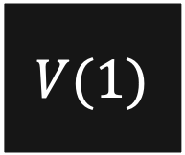
Unitary Transformation
$$|0〉$$
$$H$$
$$U(1)$$
$$m_{1,j}$$
$$|0〉$$
$$m_{2,j}$$
$$H$$
$$α$$
$$β$$
$$|0〉$$
$$V(1)$$
$$m_{i,1}$$
$$|0〉$$
$$m_{i,2}$$

Slide 24


Unitary Transformation – U(01)
m_{i,1}
X₁ ⊗ I₂
m_{1,j}
$$U1≔\left(H⊗I\right) \\ \text{=} U^{†}\left(Z⊗I\right)U=\left(H⊗I\right)\left(Z⊗I\right)\left(H⊗I\right) \\ =\left(HZH\right)⊗\left(III\right)=X⊗I$$
I₁ ⊗ Z₂
m_{2,j}
$$U2≔\left(H⊗I\right) \\ {= U}^{†}\left(I⊗Z\right)U=\left(H⊗I\right)\left(I⊗Z\right)\left(H⊗I\right) \\ =\left(HIH\right)⊗\left(IZI\right)=I⊗Z$$
-X₁ ⊗ Z₂
m_{3,j}

Slide 25


Unitary Transformation – V(01)
m_{i,1}
m_{i,2}
m_{i,3}
V$1≔\left(H⊗H\right)$ $$= V^{†}\left(Z⊗I\right)V=\left(H⊗H\right)\left(Z⊗I\right)\left(H⊗H\right) \\ =\left(HZH\right)⊗\left(HIH\right)=X⊗I$$
X₁ ⊗ I₂
I₁ ⊗ X₂
X₁ ⊗ X₂
m_{1,j}
V$2≔\left(H⊗H\right)$ $$= { V}^{†}\left(I⊗Z\right)V=\left(H⊗H\right)\left(I⊗Z\right)\left(H⊗H\right) \\ =(HIH)⊗\left(HZH\right)=I⊗X$$

Slide 26




Unitary Transformation – MPG Circuit
$$|0〉$$
$$H$$
$$H$$
$$m_{1,j}$$
$$|0〉$$
$$m_{2,j}$$
$$H$$
$$I$$
$$|0〉$$
$$H$$
$$m_{i,1}$$
$$|0〉$$
$$H$$
$$m_{i,2}$$

Slide 27
Quantum Circuit - Example Column & Row := 1
0000
m_{i,3} = m_{i,1} + m_{i,2} mod 2
m_{3,j} = m_{1,j} + m_{2,j} + 1 mod 2
0
1
Bob: 000
Alice: 001

Slide 28
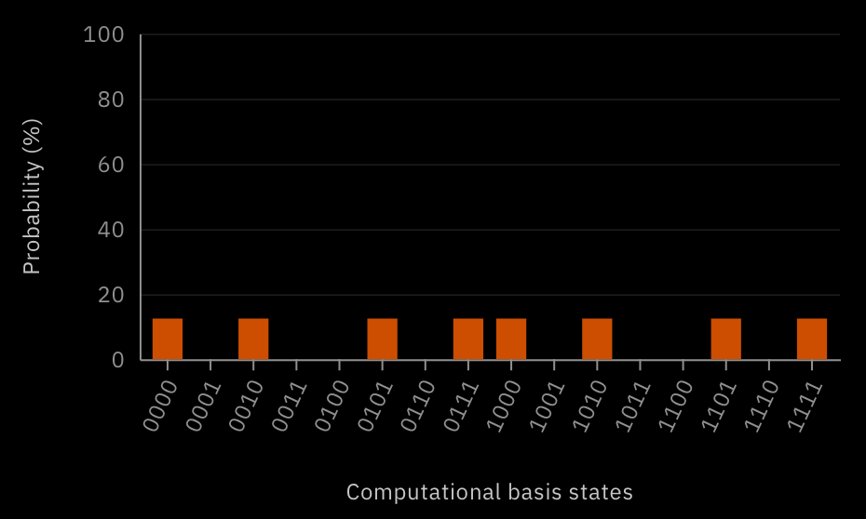
Quantum Circuit - Example Column & Row := 1
Winning probability: 100%

Slide 29


Mermin Peres Magic Square Circuit
m_{i,1}
m_{i,2}
m_{i,3}
+1
+1
+1
m_{1,j}
$${\underset{i=1}{\overset{3}{Π}} m}_{i,1}=+1$$
+1
m_{2,j}
-1
m_{3,j}
$${\underset{j=1}{\overset{3}{Π}} m}_{1,j}=−1$$

Slide 30
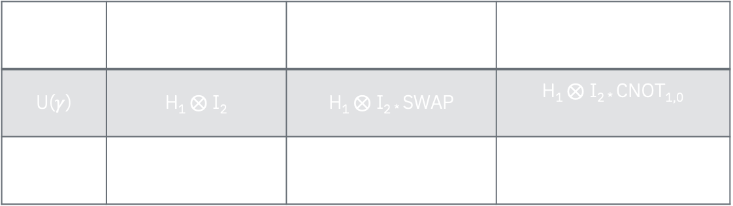
Mermin Peres Magic Square Circuit
$$γ$$ | $γ$=01 | $γ$=10 | $γ$=11
U($γ$) | H₁ ⊗ I₂ | H₁ ⊗ I_{2 *} SWAP | H₁ ⊗ I_{2 *} CNOT_{1,0}
V($γ$) | H₁ ⊗ H₂ | SWAP | (H₁ ⊗ H_{2) *} CZ * (Z₁ ⊗ Z₂)

Slide 31
Mermin Peres Magic Square Circuit
On the QASM-Simulator a winning probability of 100% is achievable…
Then, what is the performance on NISQ devices? Is the fidelity on IBM devices higher than the classical 8/9 winning probability?

Slide 32
MPG on Real Quantum Computers
Quantum Device | Fidelity | Qubits | Quantum Volume | Date
ibmqx2 | 52.09% | 5 | 8 | 27.04.2021 22:38 CEST
ibmq_16_melbourne | 56.69% | 15 | 8 | 27.04.2021 22:41 CEST
ibmq_lima | 78.59% | 5 | 8 | 27.04.2021 22:56 CEST
ibmq_quito | 65.52% | 5 | 16 | 27.04.2021 23:04 CEST
ibmq_belem | 68.84% | 5 | 16 | 27.04.2021 23:01 CEST
ibmq_santiago | 87.18% | 5 | 32 | 27.04.2021 22:54 CEST
Ibmq_athens | 94.26% | 5 | 32 | 27.04.2021 22:47 CEST

Slide 33
Key Takeaways
Real quantum computers can achieve superior results running the Mermin-Peres Magic Square Game
At least a quantum volume of 32 is required to produce comparable results, so for an n-Dimensional version more quantum volume is required
Reading direction of quantum circuits is essential

Slide 34

Notebook & Presentation
https://github.com/JanLahmann/Fun-with-Quantum
drexlin.david@web.de / https://www.linkedin.com/in/daviddrexlin/

